Slide 1
Travel ai agent
IBM HACKATHON PROJECT
Presented By:
Student name :Sanket Banate
College Name & Department : MIT ACADEMY OF ENGINEERING ALANDI, PUNE . COMPUTER ENGINEERING

Slide 2
OUTLINE
Problem Statement
Technology used
Wow factor
End users
Result
Conclusion
Git-hub Link
Future scope
IBM Certifications

Slide 3
Problem Statement
Planning a trip can be overwhelming and time-consuming, especially with the abundance of travel information scattered across multiple platforms. Users often struggle to decide on destinations, create efficient itineraries, find reliable accommodation or transport options, and adapt plans based on seasonal, weather, or budget constraints. The lack of personalised and real-time travel guidance results in missed opportunities, inefficient plans, or increased costs—making travel planning a frustrating experience for many.
Proposed Solution: The proposed solution is an intelligent Travel Planner Agent, an AI-powered assistant built using IBM Watsonx.ai and IBM Granite. The agent interacts with users in natural language and provides personalised travel recommendations such as: Destinations based on season, budget, and interest Day-wise itineraries, Suggested transport and accommodation, Local experiences, food, and weather tips. It integrates live data from sources like Google Search, DuckDuckGo, weather APIs, and travel blogs to ensure accurate and timely responses.

Slide 4
Technology used
1. IBM Granite (LLM – Large Language Model)
Model: granite-3-3b-instruct
Purpose: Natural Language Understanding & Generation
Supports Retrieval-Augmented Generation (RAG) for enhanced accuracy.
2. IBM Watsonx.ai
Platform to access and interact with IBM Granite models.
Enables prompt execution, tool integration, and AI assistant logic.
Running the AI model with user prompts
Configuring instructions and behaviour constraints (e.g., travel-only scope)
3. IBM Cloud Lite
Hosting and deployment environment.
Deploy the AI agent backend
Host and serve APIs or frontend components
Ensure secure and scalable access to the assistant

Slide 5
IBM cloud services used
IBM Cloud Watsonx AI Studio
IBM Cloud Watsonx AI runtime
IBM Cloud Agent Lab
IBM Granite foundation model

Slide 6
Wow factors
Conversational Trip Planning: Users can plan entire trips simply by chatting with the AI — no need to visit multiple travel websites or apps.
Personalised Itinerary Generation: Creates detailed, day-by-day itineraries tailored to the user’s preferences, travel duration, season, and budget.
Real-Time Relevance via RAG: Uses Retrieval-Augmented Generation (RAG) to dynamically include live search results, seasonal travel tips, and local recommendations.
Smart Destination Matching: Suggests travel locations based on weather, time of year, interests (e.g., beach, adventure, culture), and budget constraints.
Local Experience & Culture Embedding: Recommends not just tourist attractions, but also food, festivals, packing tips, and safety advice — enhancing the cultural depth of the plan.
Multi-source Knowledge Integration: Simulates responses using data from trusted platforms like MakeMyTrip, Goibibo, RedBus, TripAdvisor, and real-time web search.
Budget Optimization Suggestions: Offers cost-conscious alternatives for hotels, transport, and activities — perfect for students, backpackers, or budget travelers.
Zero-Frustration Interface: Eliminates the hassle of switching between multiple apps by bringing all planning elements into a single smart assistant.

Slide 7
End users
Students & Budget Travelers
Working Professionals
Families & Group Travelers
Travel Bloggers & Content Creators
Solo Travelers

Slide 8
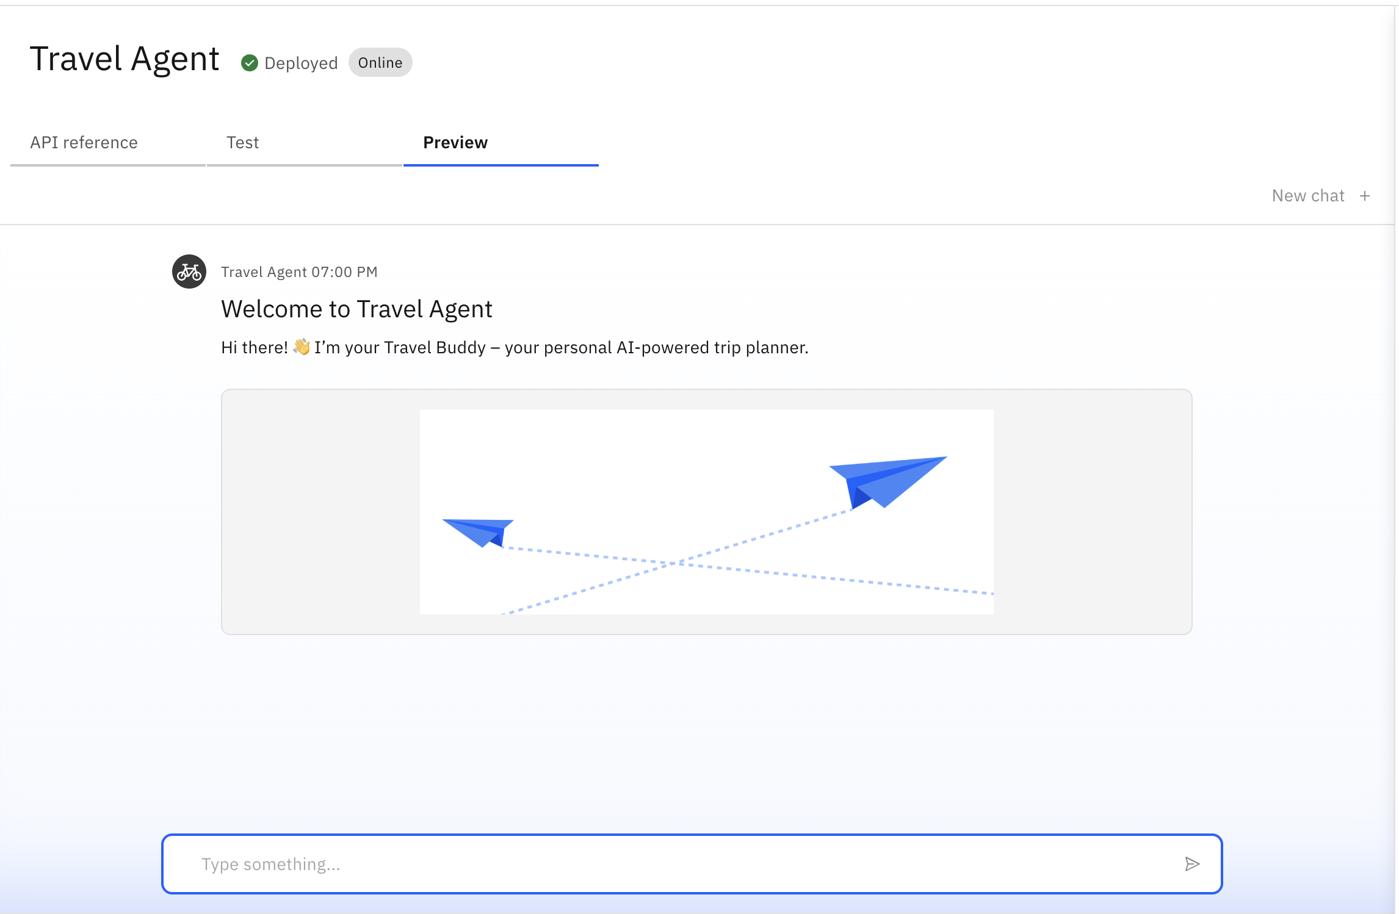
Results

Slide 9
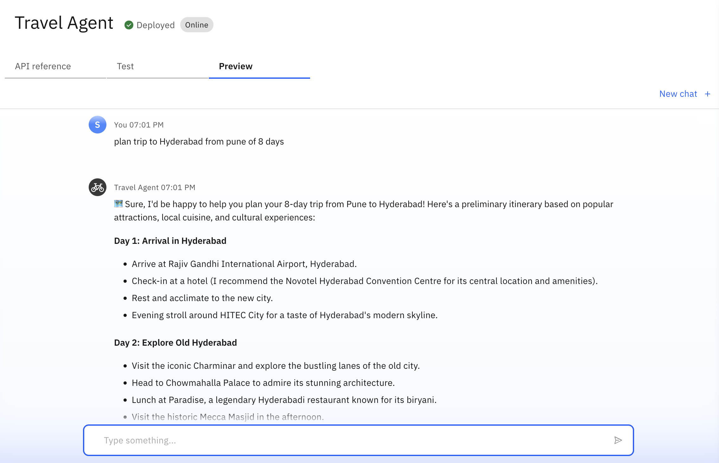
Results

Slide 10
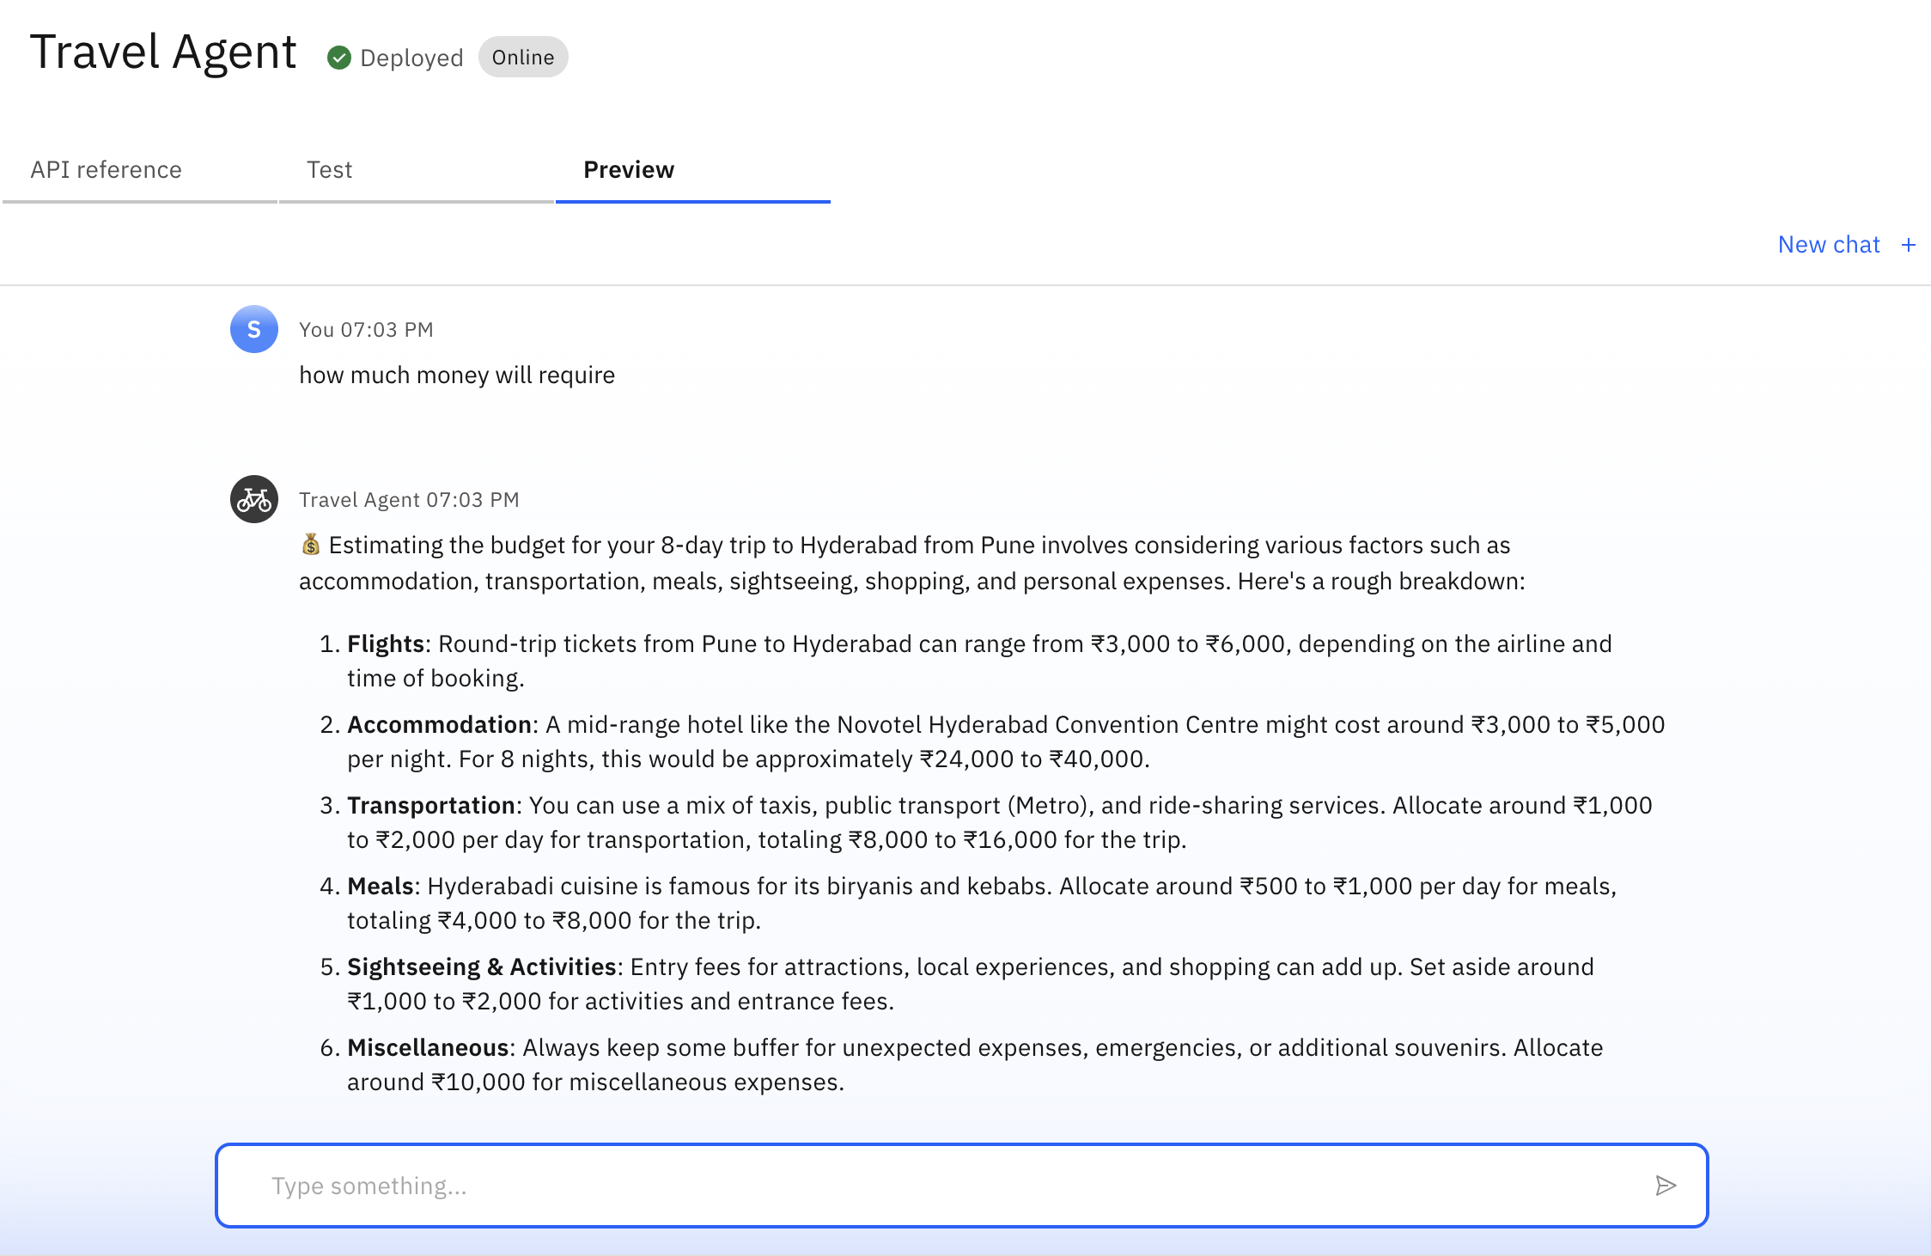
Results

Slide 11
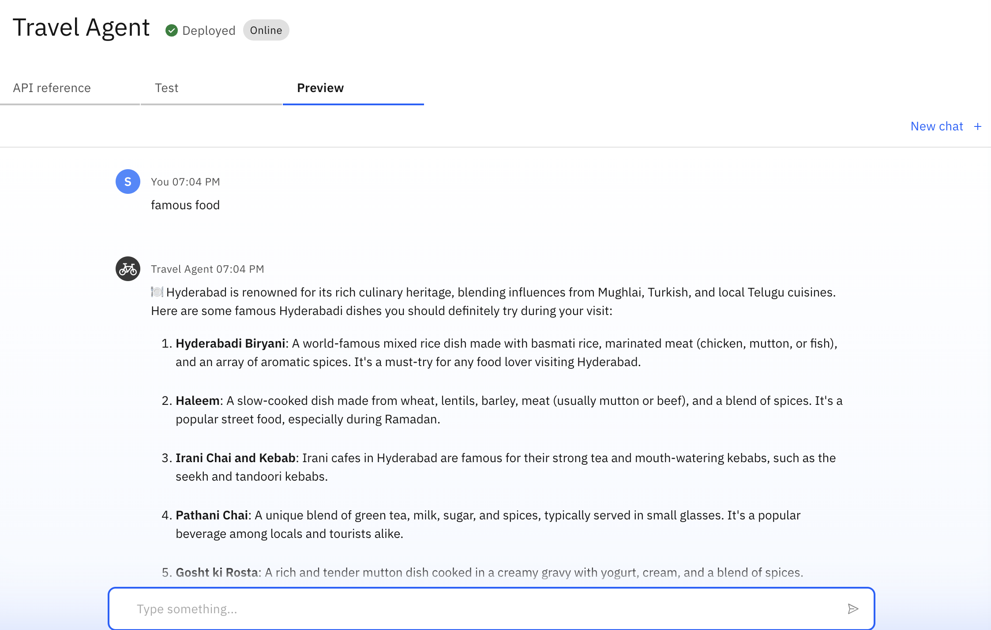
Results
Deployed AI Agent

Slide 12
Conclusion
The Travel Planner Agent effectively simplifies travel planning by using the power of generative AI and retrieval-augmented intelligence. It delivers personalised, real-time answers tailored to user goals and budgets. The use of IBM Granite ensures conversational fluency, while tools like web crawlers and weather APIs enhance accuracy. The project demonstrates how Agentic AI can transform traditional trip planning into a smart, seamless experience.

Slide 13
GitHub Link
https://github.com/Wolverine0007/Travel-Planner-AI-Agent

Slide 14
Future scope
Add multilingual support for Indian languages
Integrate live hotel and flight booking APIs
Enable voice-based query input
Add user profile & saved plans feature
Deploy as a mobile app for wider reach

Slide 15
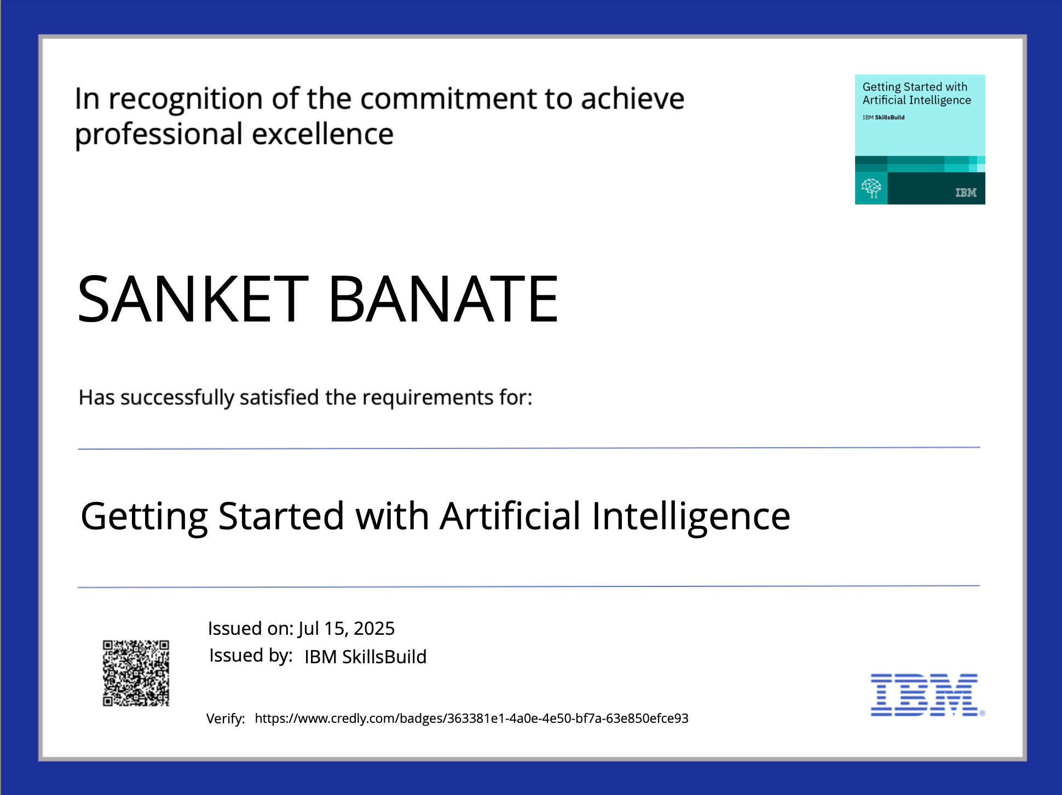
IBM Certifications

Slide 16
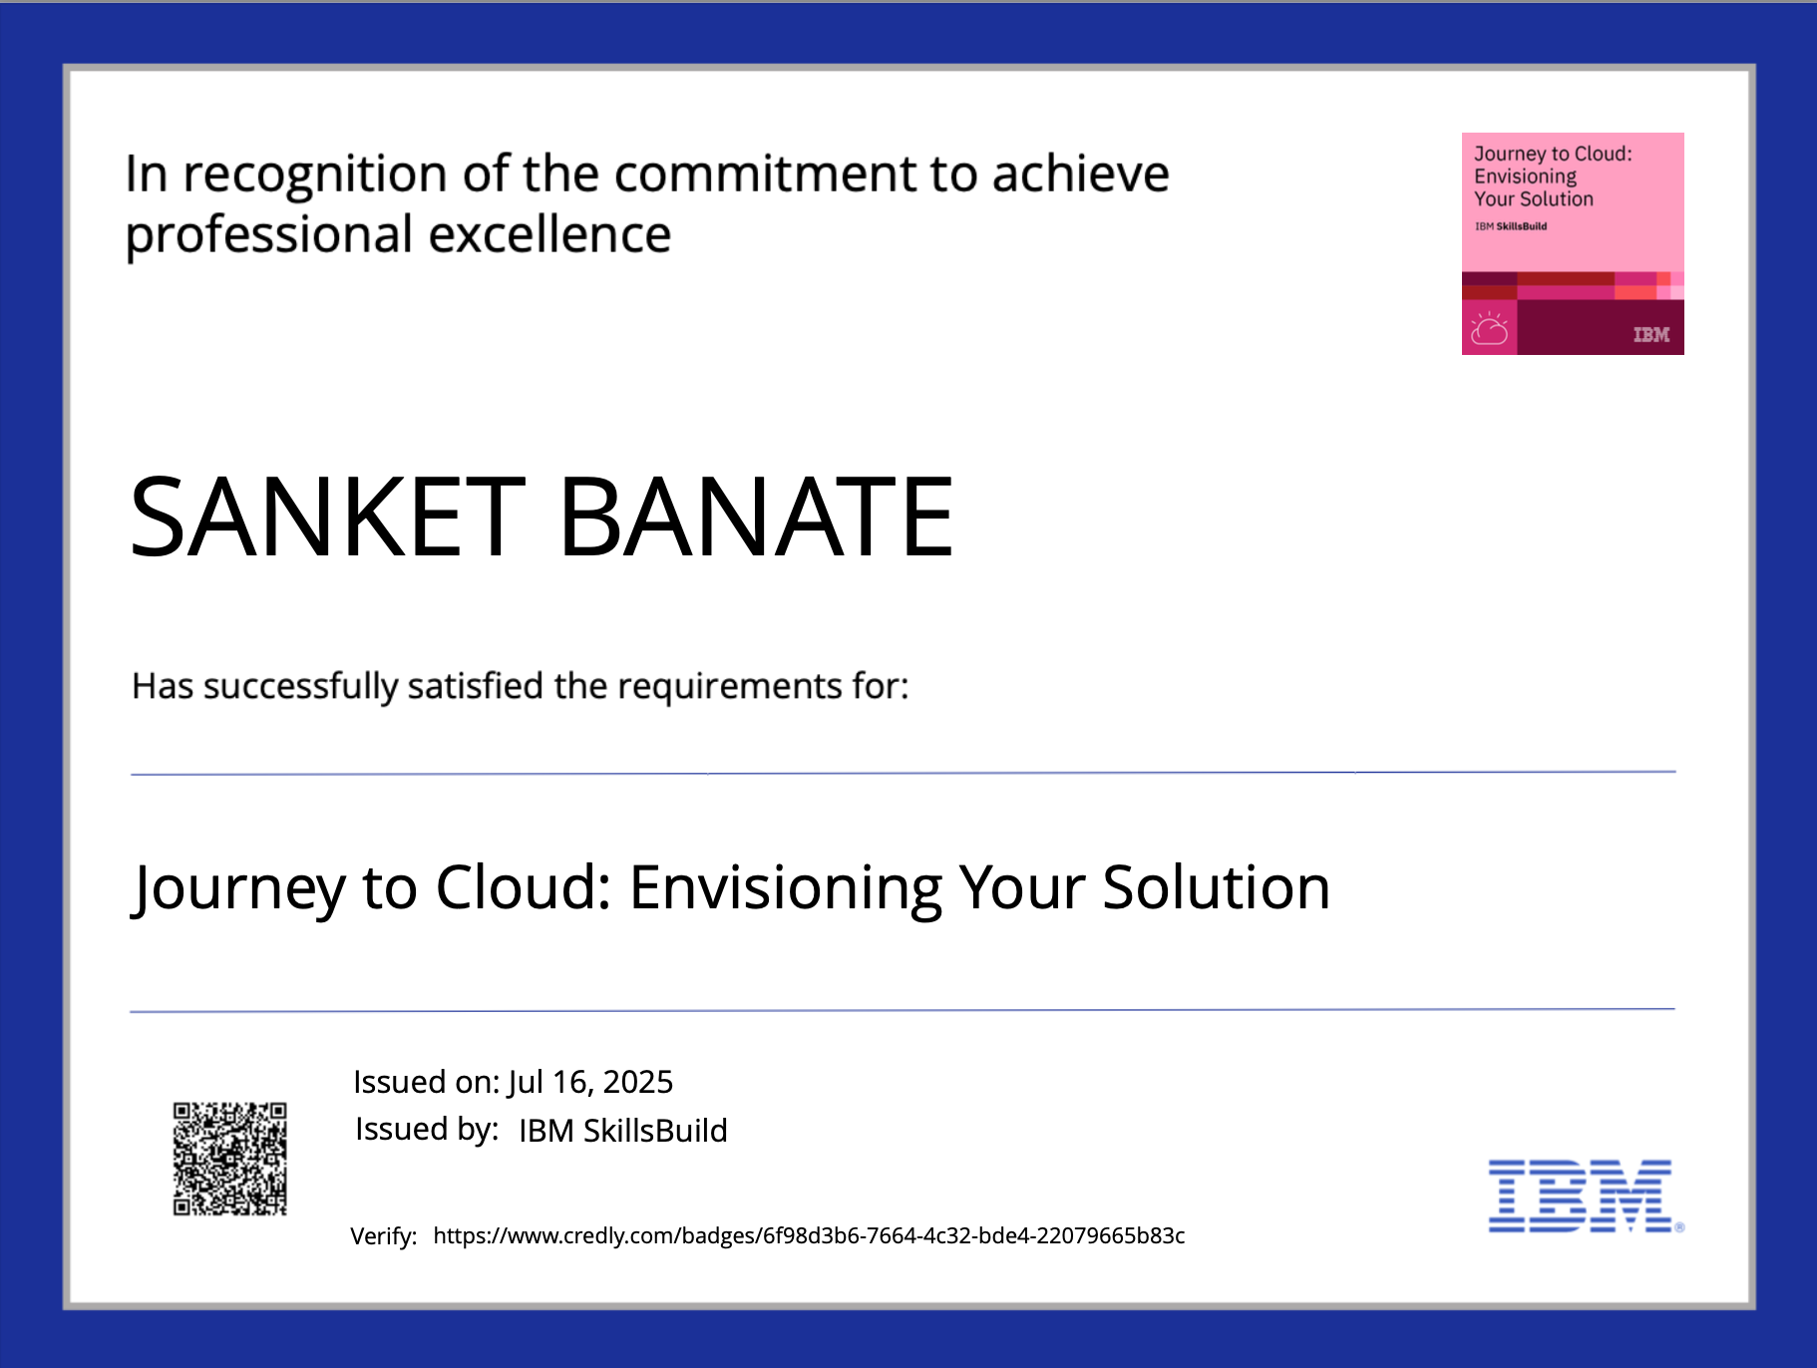
IBM Certifications

Slide 17
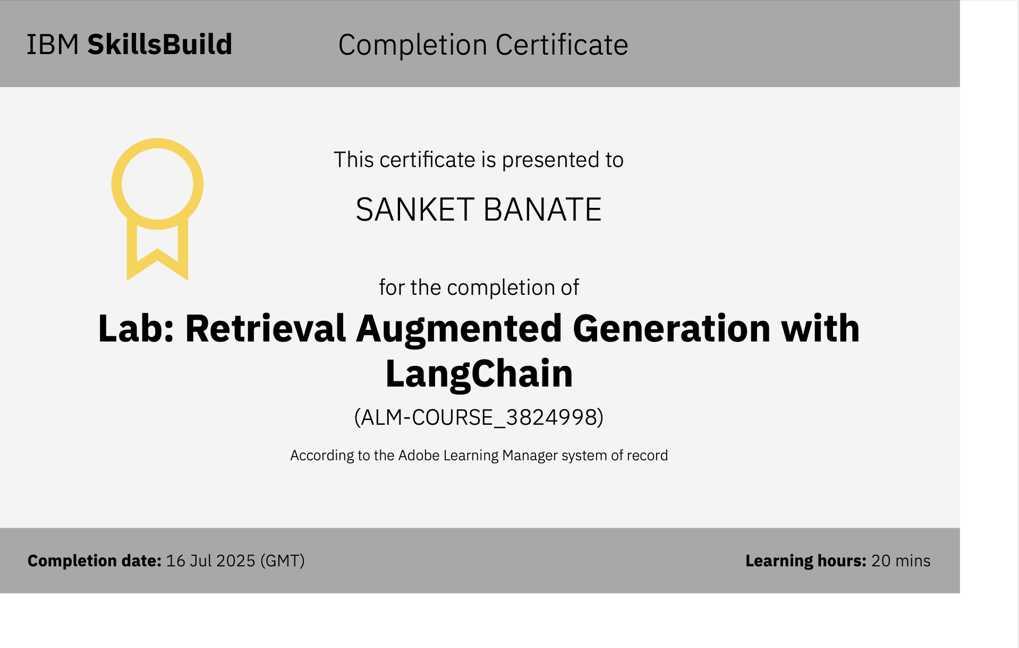
IBM Certifications

Slide 18
THANK YOU

